Slide 1

Mismatched training and dev/test data
Addressing data
mismatch
deeplearning.ai

Slide 2
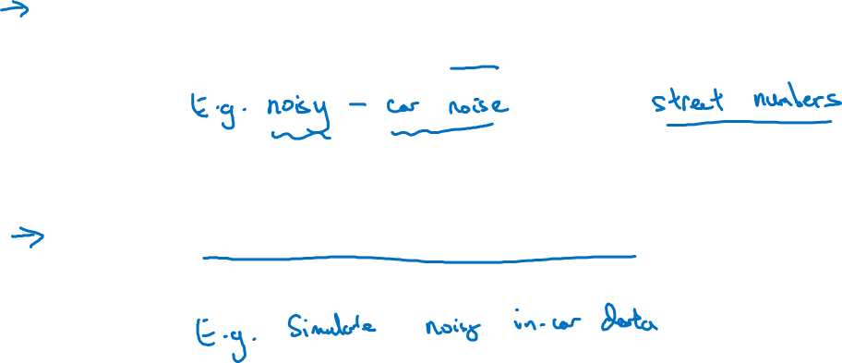
Addressing data mismatch
Carry out manual error analysis to try to understand difference
between training and dev/test sets
Make training data more similar; or collect more data similar to
dev/test sets

Slide 3

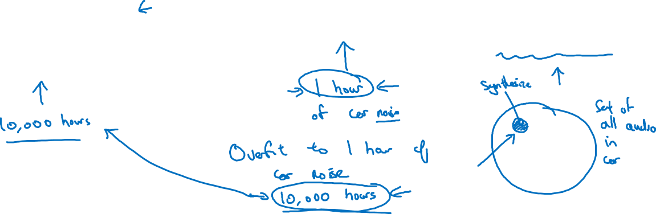
Artificial data synthesis
+
=
“The quick brown fox jumps
over the lazy dog.”
Car noise
Synthesized
in-car audio
Notes:
take this one hour
of car noise and repeat it 10,000 times in
order to add to this 10,000 hours of data recorded against a quiet background.
If you do that, the audio will sound perfectly fine to the human ear,
but there is a chance,
there is a risk that your learning algorithm will over fit to the one hour of car noise.
And, in particular, if this is the set of
all audio that you could record in the car or,
maybe the sets of all car noise backgrounds you can imagine,
if you have just one hour of car noise background,
you might be simulating just a very small subset of this space.
You might be just synthesizing from a very small subset of this space.
And to the human ear,
all these audio sounds just fine because one hour of car noise
sounds just like any other hour of car noise to the human ear.
But, it's possible that you're synthesizing data from a very small subset of this space,
and the neural network might be
overfitting to the one hour of car noise that you may have.

Slide 4
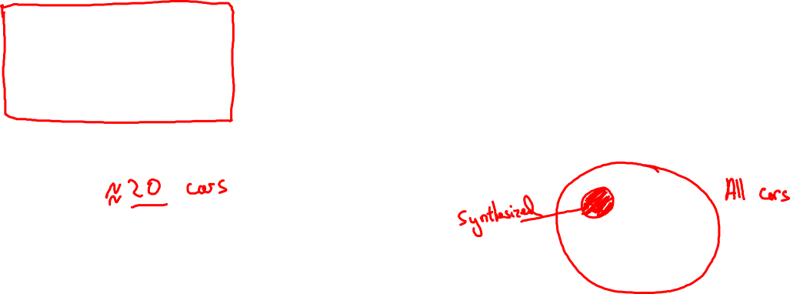
Artificial data synthesis
Car recognition:
Notes:
to summarize, if you think you have a data mismatch problem,
I recommend you do error analysis,
or look at the training set,
or look at the dev set to try this figure out,
to try to gain insight into how these two distributions of data might differ.
And then see if you can find some ways to get
more training data that looks a bit more like your dev set.
One of the ways we talked about is artificial data synthesis.
And artificial data synthesis does work.
In speech recognition, I've seen artificial data synthesis significantly
boost the performance of what were already very good speech recognition system.
So, it can work very well.
But, if you're using artificial data synthesis,
just be cautious and bear in mind whether or not you might be accidentally
simulating data only from a tiny subset of the space of all possible examples.

